Slide 1


ECEN 403 Final Presentation Team 16 | Solar Battery Team
Lauren Lugo, Tarik Dawson, Clement Ong, Nathan Gil Peng-Hao Huang

Slide 2
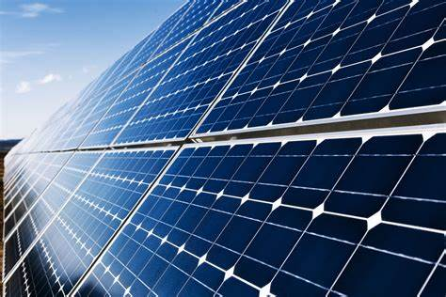
Executive Summary
Problem statement:
Clean, accessible, power to preserve the environment
Provide the user with an independent solar power generating system that can charge both AC and DC devices
Everything needs power, computers, smartphones, accessories, etc.
Create security by providing a battery to switch to for discrepancies in generation of power from solar panels

Slide 3
System Overview
Clement
DC Bus
DC-AC Inverter
AC Load
Tarik
Solar Panel
DC-DC Converter
DC Load
Lauren
PWM Generator
Batteries
MPPT Algorithm (MCU)
Voltage Regulation
Nathan
Computer Application
Phone Application

Slide 4
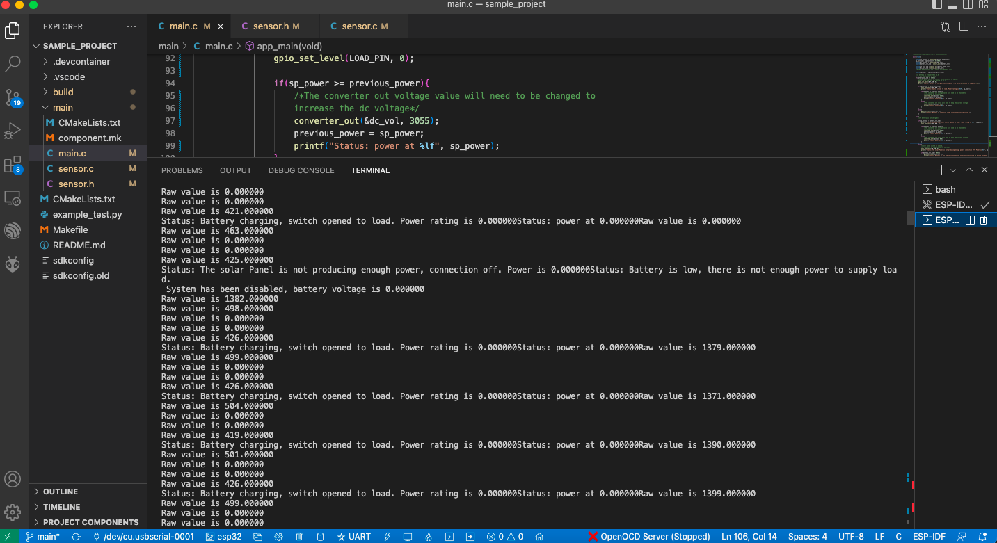
MPPT
Overview
Deliverables
Coded ESP32 to take in voltage inputs and determine appropriate action
2 Switch Circuits at outputs
3 Sensor circuits: Solar Panel Circuit: Voltage and Current Sensor
Dc-Dc Converter: Voltage and Current Sensor
Battery: Voltage Sensor
Current Problems
Missing a switch circuit
Data for output of current sensor (Calculations not accurate)
Missing data to output to the DC-DC converter

Slide 5
Overview Continued
Challenges:
Coding outputs for ESP32
Soldering Circuits
Remains to be completed:
Combining circuit design with ESP32 to PCB of DC-DC converter
Complete code for designated output voltages
Sending data to Computer and Phone Application
Additional testing with circuit and solar panel outside in sunny weather
 | Test | Actual | Met
3.2.1.3 | Switch Check | System will switch to battery power when the solar panel is not producing enough; system will open switch when solar panel is not producing; and the system will open the load switch when the battery is charging | Yes
3.2.1.5 | Max Power Point Track | System can track the max power the solar panel can give the system | No
3.2.1.6 | System Shut Off | System disconnects when not enough power is being supplied | Yes
3.2.3.1.1 | Power Consumption | The system will not consume more than 260W | Yes

Slide 6
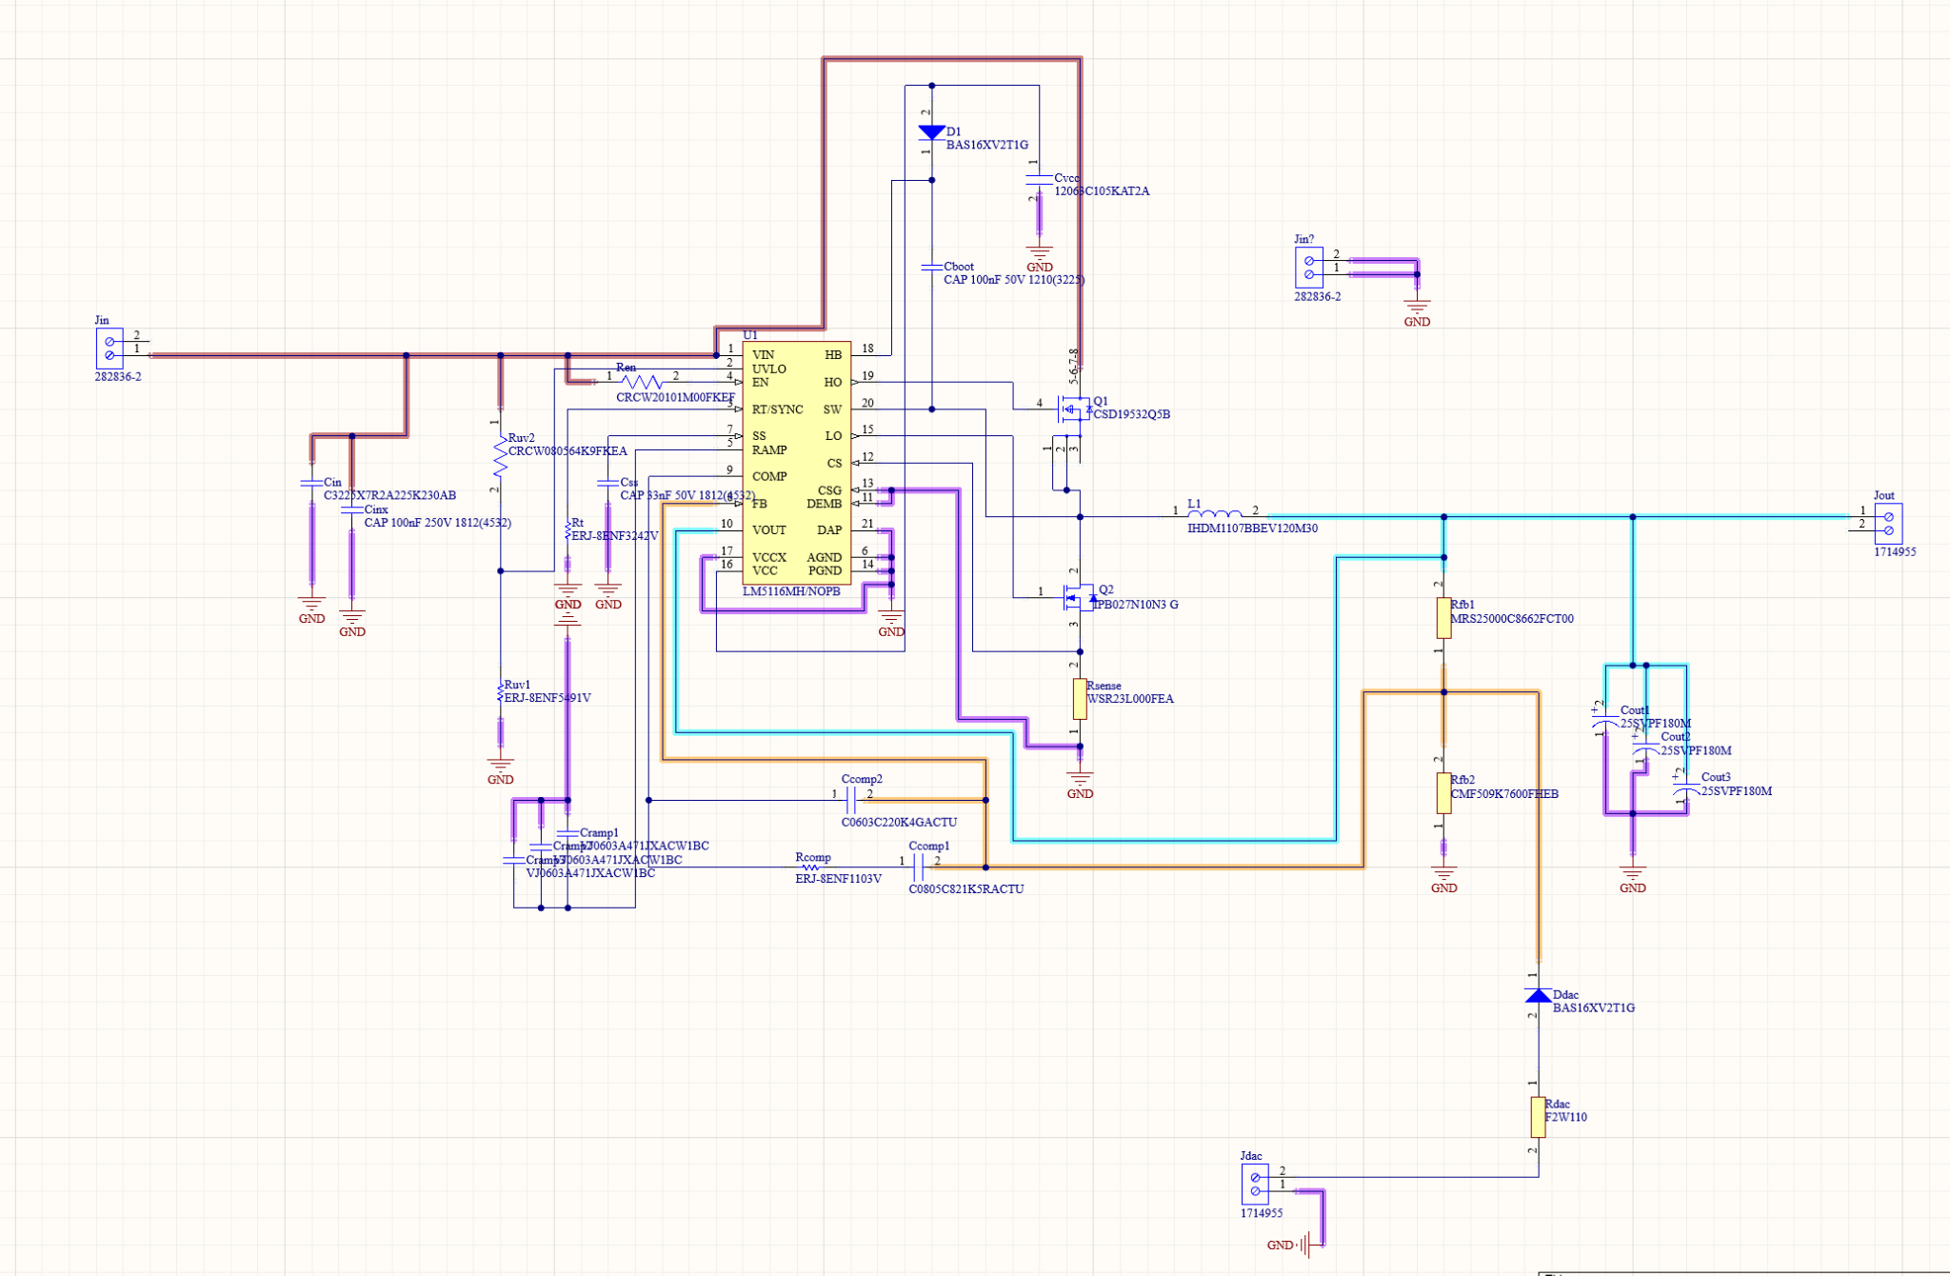
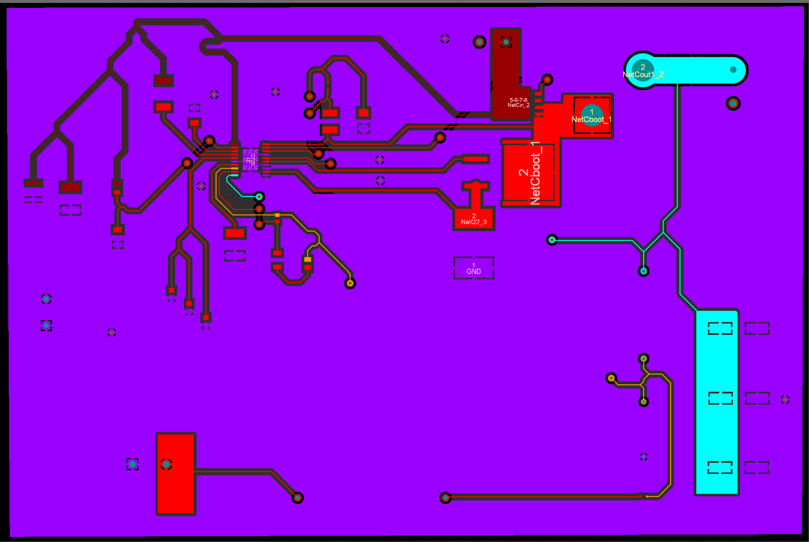
DC-DC Converter Overview
Deliverables
Designed a high current buck converter to convert variable solar power into stable 12V DC power.
Schematic fully designed.
Buck converter PCB fully designed and ordered.
PCB fully soldered. Currently in testing. See below.
Subsystem partially working until the a problem occurred in the chip
Current Problems
Pin 19 of the buck controller is not sending voltage to the first MOSFET gate.
As a result, the whole system is unoperational.

Slide 7
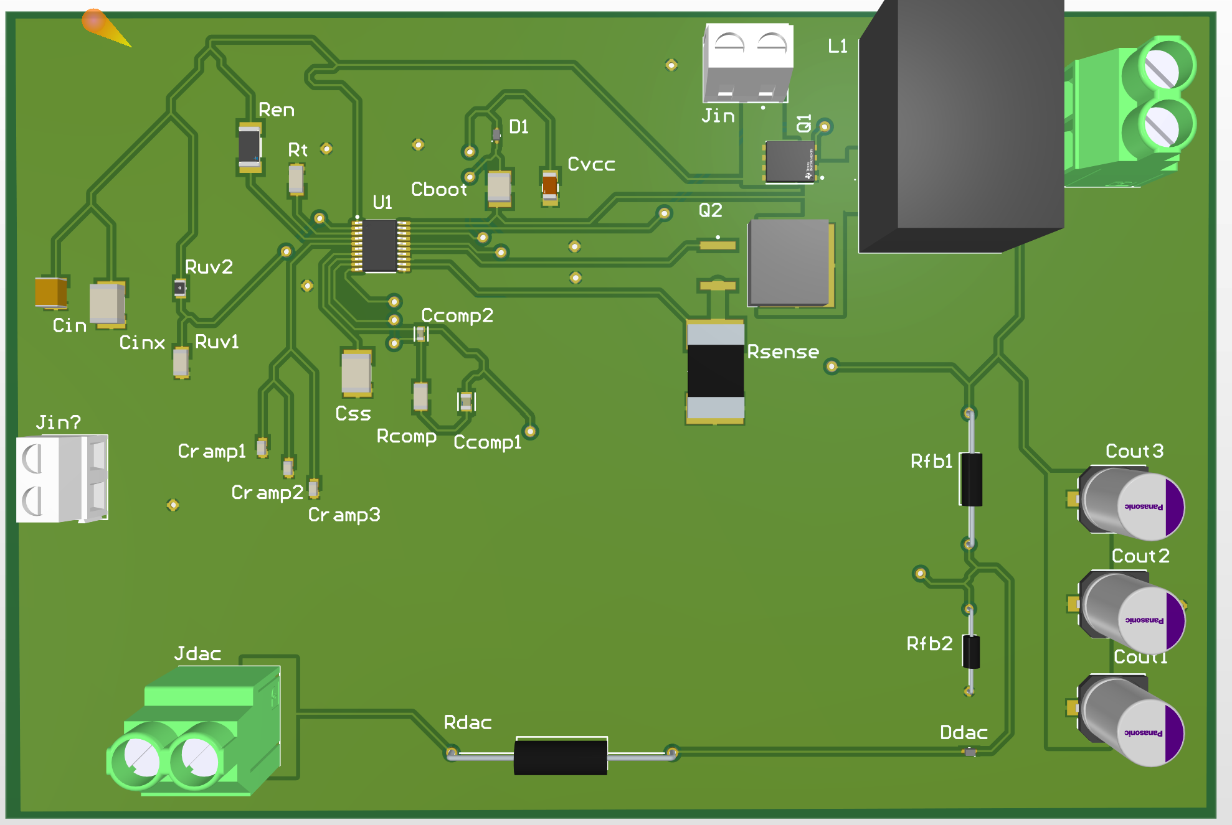
Overview Cont.
Challenges
Learning altium software
Soldering small parts
Simulating circuit (could not be simulated)
Remains to be completed
Resolder a new chip on my controller
Retest and Validate subsystem
Looking forward (404)
Improve feedback voltage system from microcontroller.
Housing fabrication
Help work on the battery charging aspect of the system.

Slide 8
DC-DC testing and validation
Test | Actual | Met
Input test | System receives full power from variable DC solar input | Yes
Chip operation test | buck controller chip working as intended | No
Output test | System provides correct 12V DC output | No
Converter Full test | System can turn 20V-60V input DC into 12V Dc output | No

Slide 9
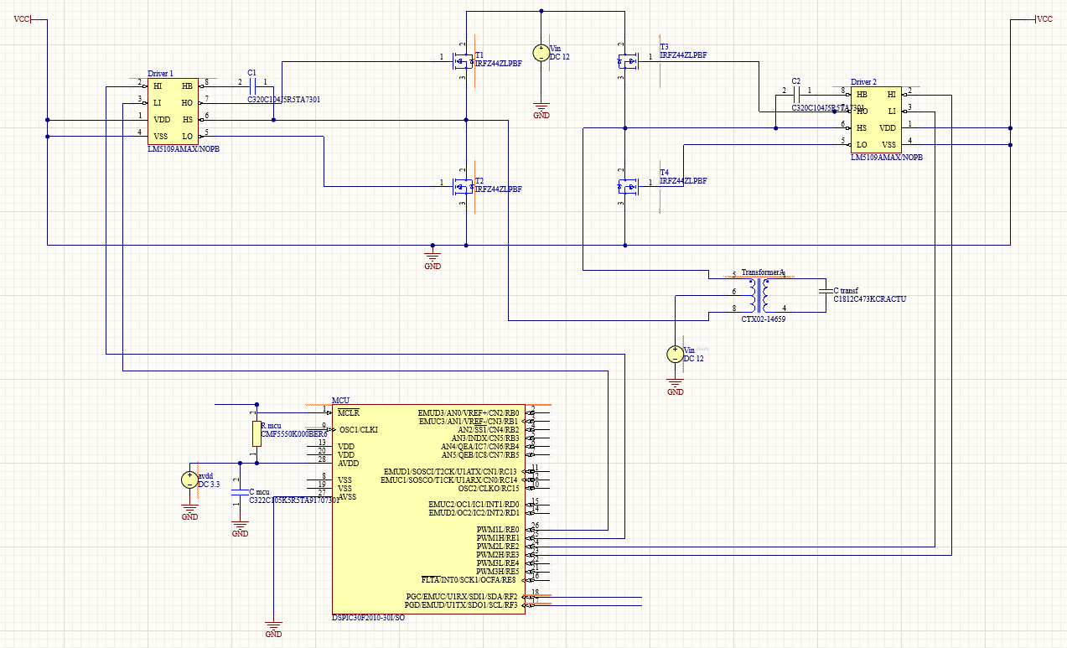
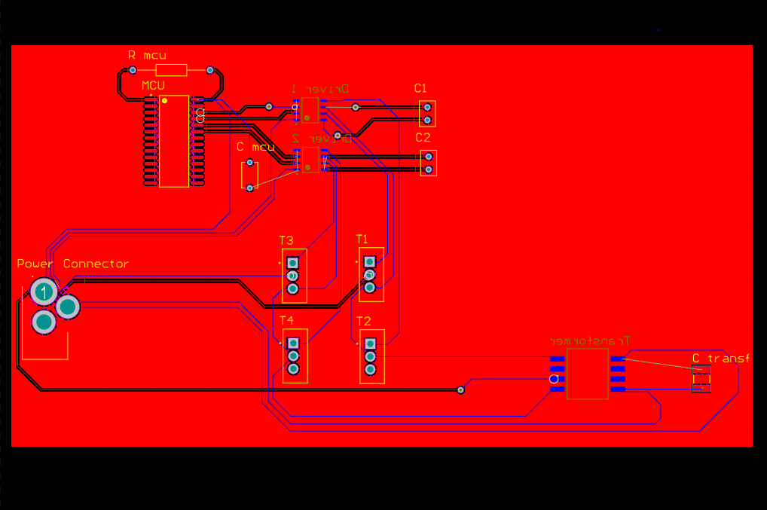
DC-AC Inverter Overview
Deliverables
Designed a DC-AC Inverter that takes in DC electricity and outputs AC electricity that is compatible with the electrical grid.
Schematic is fully designed and simulated
PCB design is completed but not finalized
Circuit is breadboarded and currently in testing
Current Problems
MOSFET Driver is not functioning properly on breadboard, switching to Perf Board and testing today.
dsPIC code contains errors, therefore it is still not completed.

Slide 10
Overview Cont.
Remains to be Completed
Finish dsPIC code and test the entire circuit with the working dsPIC on the Perf Board.
Validation
Test | Met
dsPIC generates correct PWM | No
AC output is identical to standard U.S. AC outlet power | No
Looking Forward (404)
Print and test PCB
Cooperate with other subsystems to test inverter and successfully charge a phone and a laptop.

Slide 11
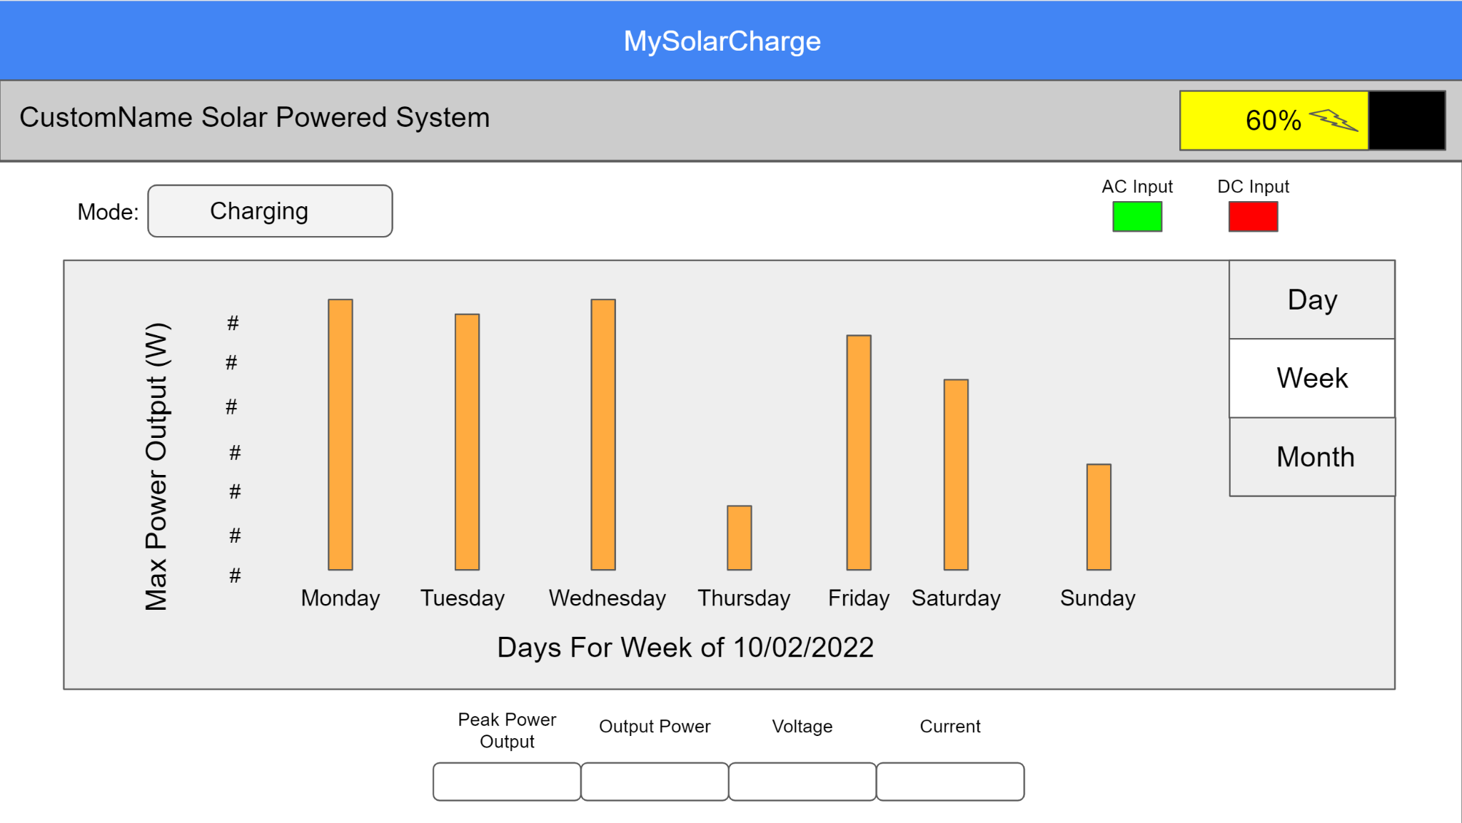
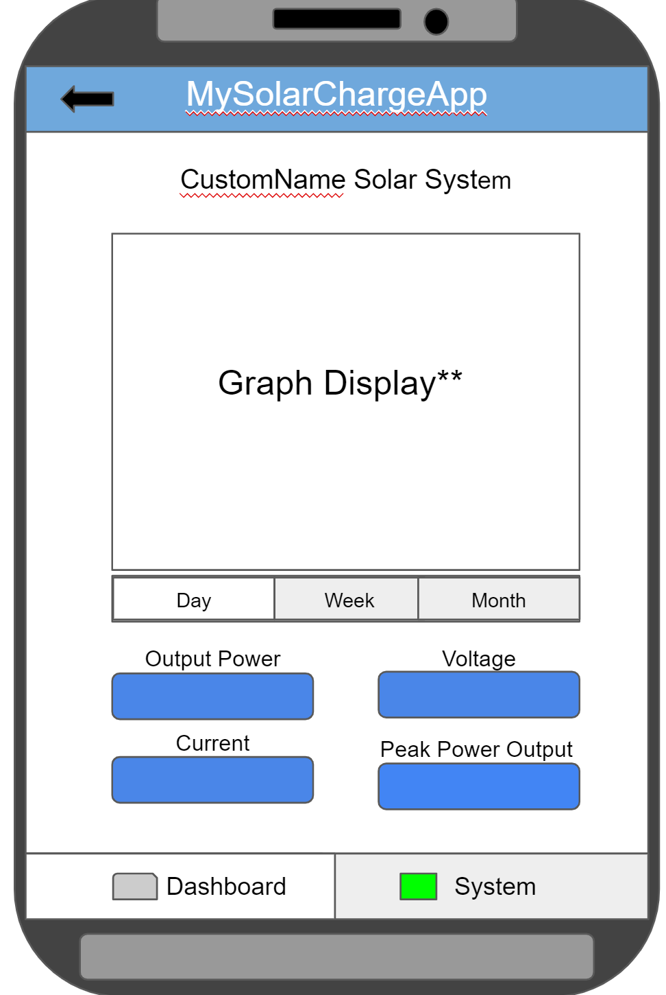
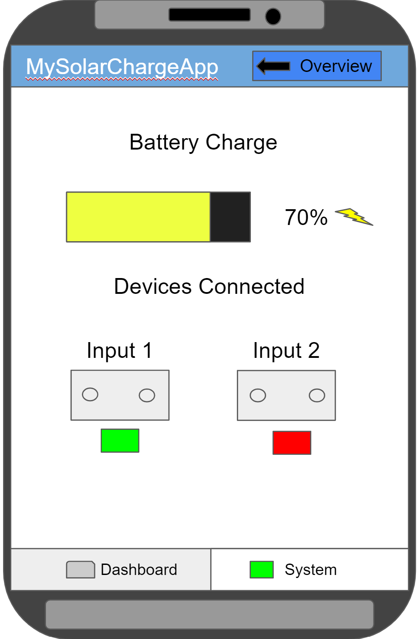
MySolarCharge Website and Android Application Overview
403 Deliverables:
Create an Android App and Website for Solar Panel System
Display Power, Current, Voltage on a graph and to the user directly
Display battery level and if the battery is charging or discharging
Display the terminals (AC or DC) when connected or disconnected from a device
Implement backend database (Firebase) to communicate with App and Website
Communicate between the front-end and back-end successfully
Challenges:
Learn Ionic to develop website and app concurrently
Implement graphs from a graphing package (chartjs) / how to communicate with Firebase from App
Figure 1. Initial Design for Android App and Website

Slide 12
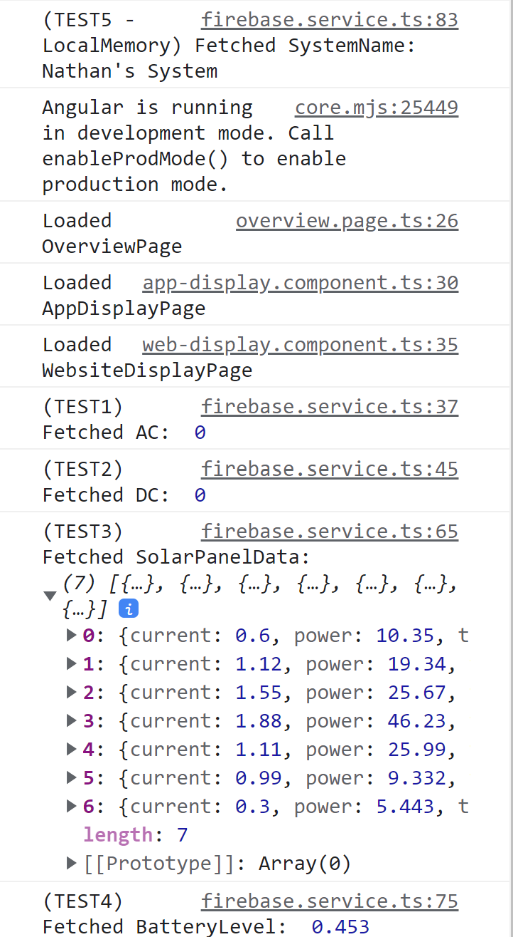
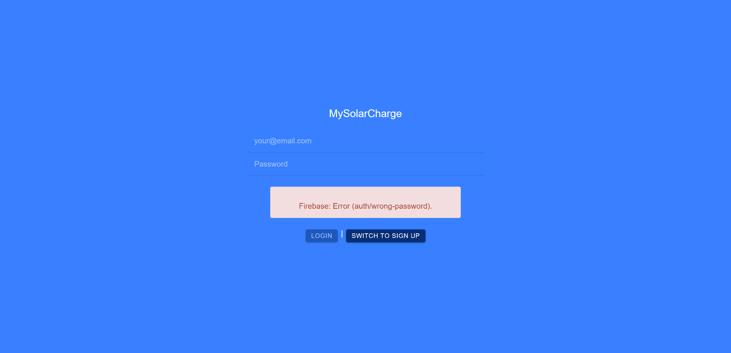
MySolarCharge Test and Validation
Figure 2. Authentication Validation (Wrong Password, Invalid Email, No User, Already Created User) Etc.
Figure 3. Successfully Getting Data from Backend Database

Slide 13
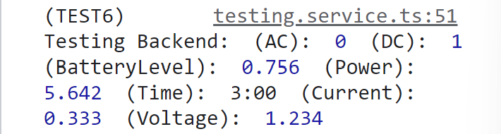

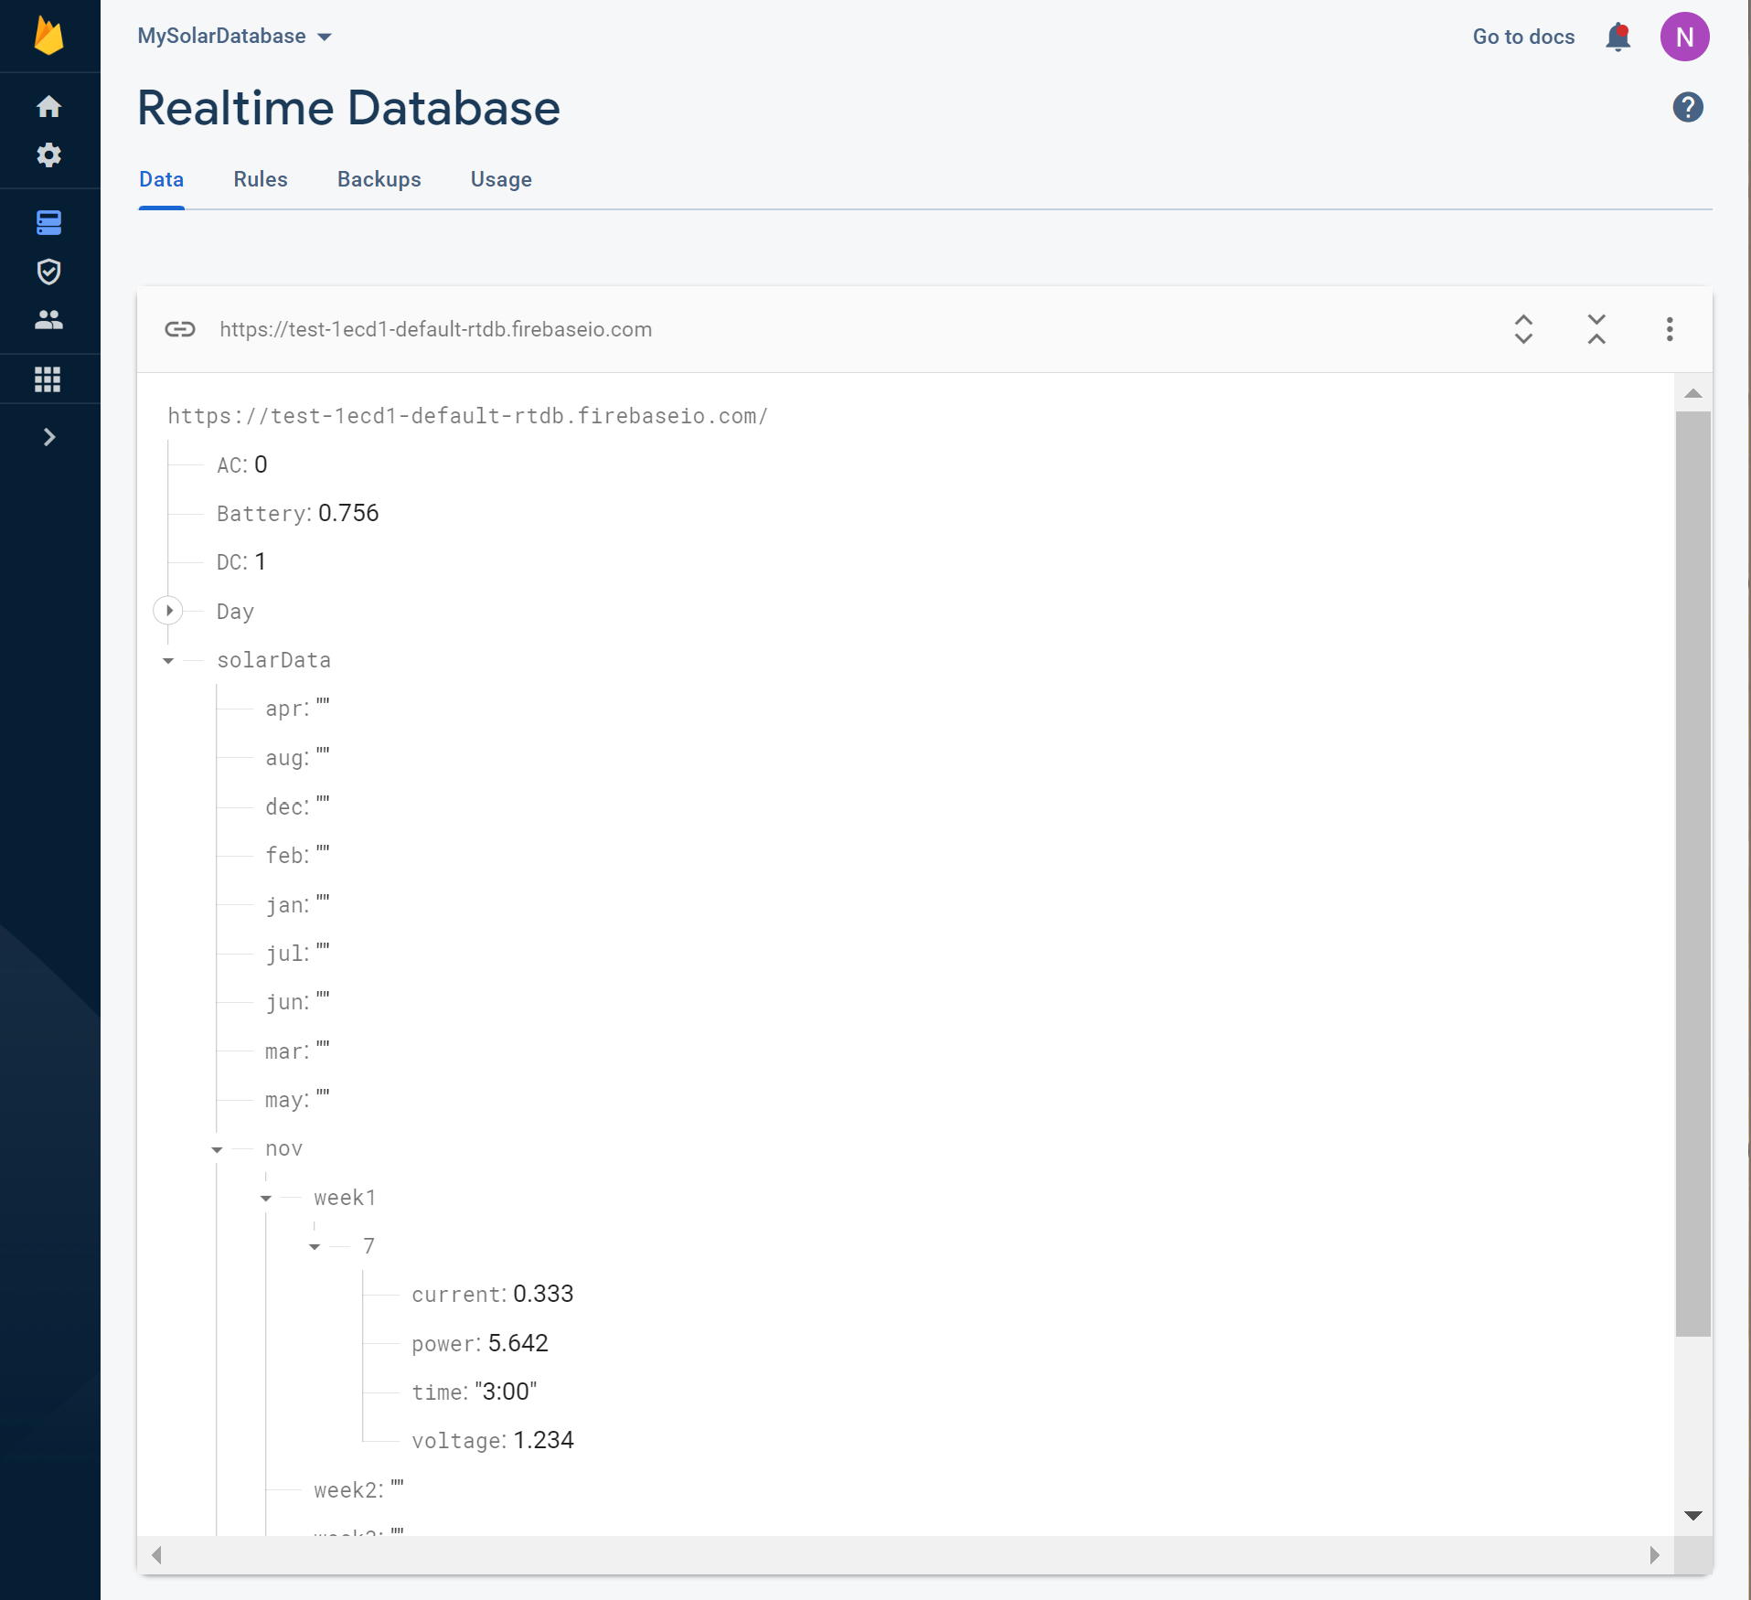
MySolarCharge Test and Validation
Test | Actual | Met
The website/application subsystem is receiving data | Receiving all data from backend database
The website/application subsystem is receiving data dynamically | Able to dynamically update power graph and display parameters
Application and Website provides correct data depending on day, week, and month | Correctly displays current day data, week and month still need to be incorporated further
Firebase Backend Database successfully receives and categorizes data | Can write to backend and send data to correct node in database tree
Website and Application works on android phone along with displaying properly | Displays well on website and android devices.
Figure 4. Sending Data from Application to Backend Database
Figure 5. Backend Database Successfully Categorized Received Data from Frontend

Slide 14
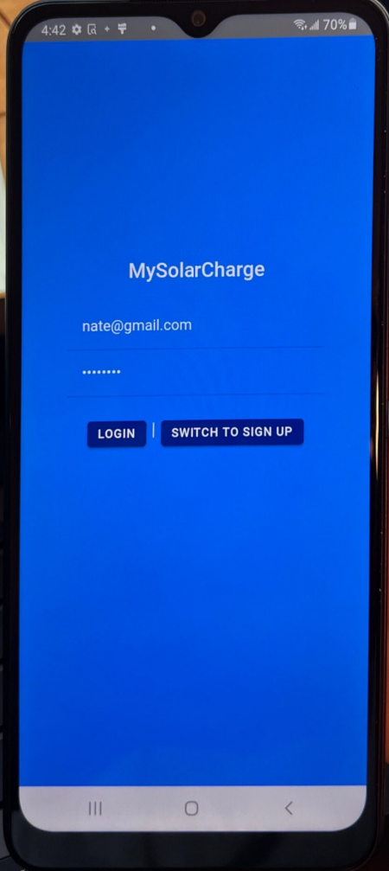
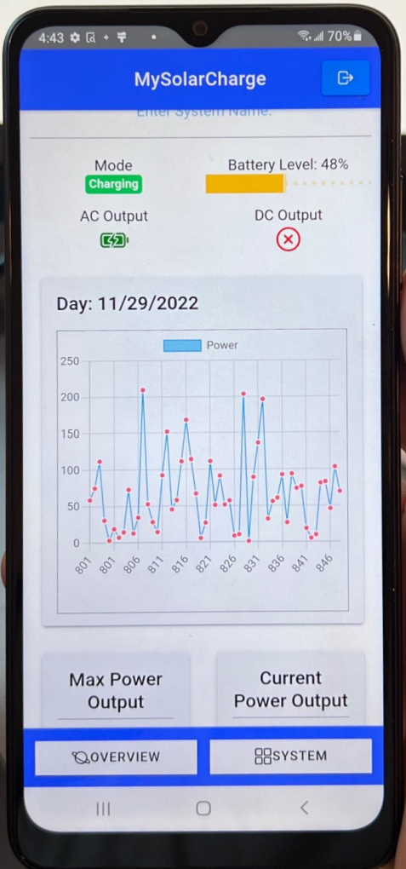
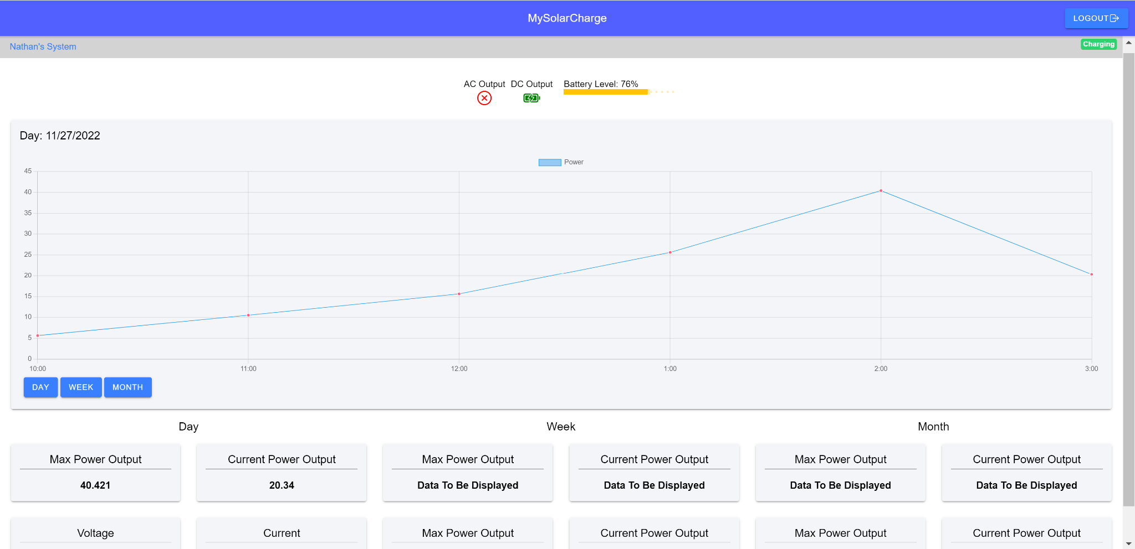
MySolarCharge 404
Receive data from the ESP 32
Implementation of Week and Month Data (handling data) with Assembled System
Testing longevity of app
Making it applicable for yearly basis solar charging
This means making sure website and app will not need updating or maintenance after 404
Figure 6. Website Final Design
Figure 7. App Final Design
Figure 8. App Final Design

Slide 15
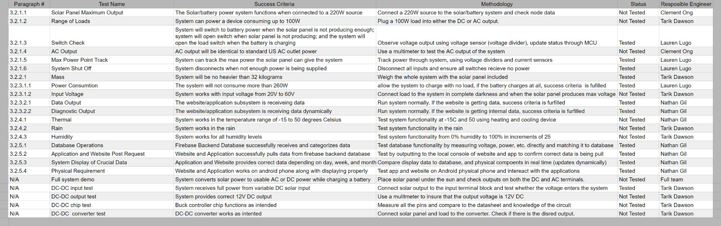
Validation Plan

Slide 16
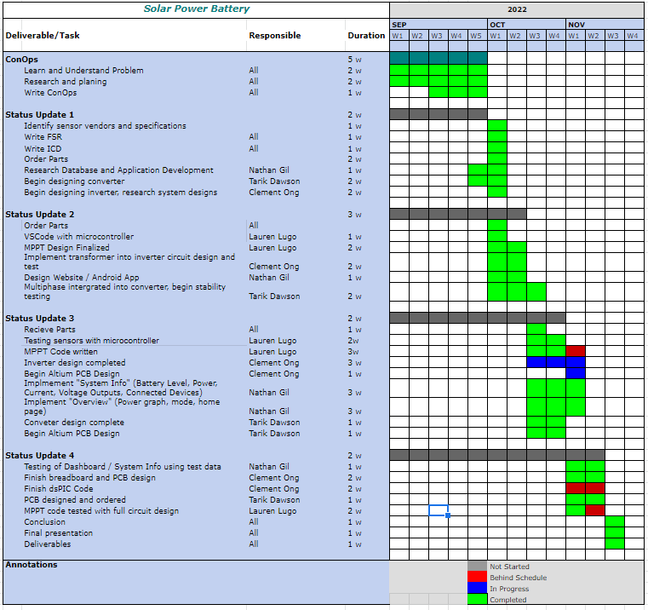
Execution Plan

